Slide 1


JAVA
Secure Coding Principles
By Thais Martin Baramarchi

Slide 2


INTRODUCTION
This presentation has the objective of showing how to protect your web applications, enterprise solutions and mobile apps from attackers using secure coding practices
INTRODUCTION

Slide 3
SUMMARY
Secure Coding
Common Security Issues
Examples and Solutions
Checklist
SUMMARY

Slide 4
SECURE CODING
Why is it so important?

Slide 5


Data Integrity and Privacy
Trust and Reputation
Financial Impact
Legal and Regulatory Compliance
Ethics
SECURE CODING

Slide 6
SECURITY ISSUES
The most common

Slide 7

INJECTION FLAWS
SQL Injection, Command Injection
An injection flaw is a vulnerability which allows an attacker to relay malicious code through an application to another system.
SECURITY ISSUES

Slide 8
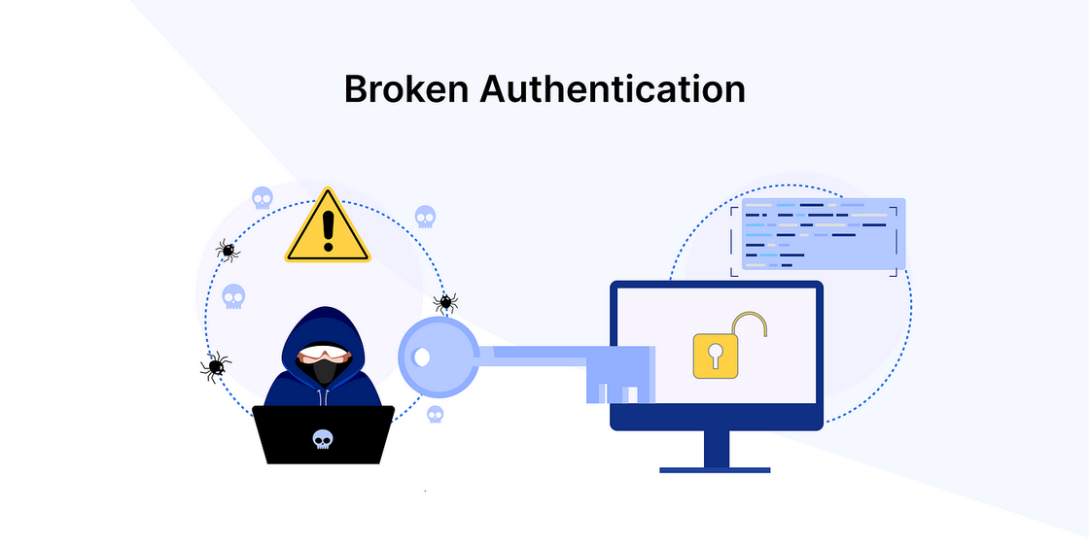
BROKEN AUTHENTICATION AND SESSION MANAGEMENT
Weak Password Policies, Session Hijacking
Broken authentication is typically caused by poorly implemented authentication and session management functions.
SECURITY ISSUES

Slide 9
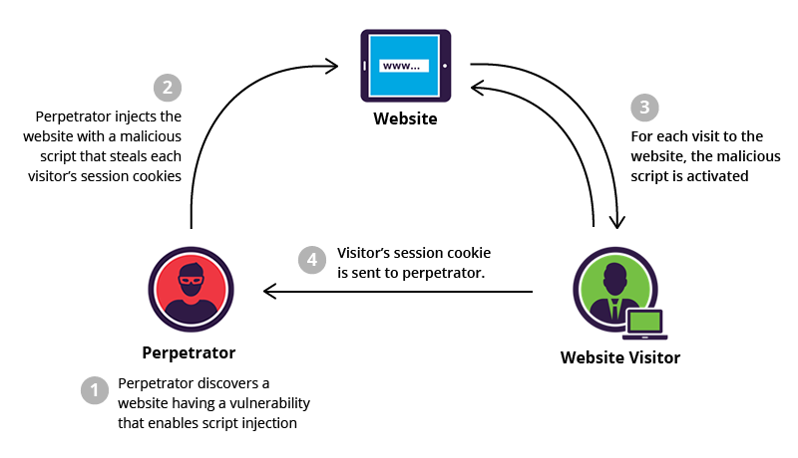
CROSS-SITE SCRIPTING(XSS)
Injection of Malicious scripts into web pages
Cross-site scripting (XSS) is an attack in which an attacker injects malicious executable scripts into the code of a trusted application or website.
Attackers often initiate an XSS attack by sending a malicious link to a user and enticing the user to click it.
SECURITY ISSUES

Slide 10
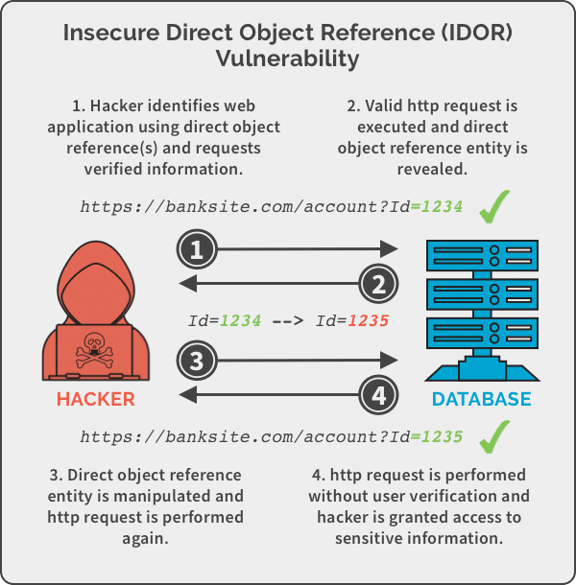
INSECURE DIRECT OBJECT REFERENCES
Exposing Internal Object References for Users
It is a vulnerability that arises when attackers can access or modify objects by manipulating identifiers used in a web application's URLs or parameters.
It occurs due to missing access control checks, which fail to verify whether a user should be allowed to access specific data.
SECURITY ISSUES

Slide 11

SECURITY MISCONFIGURATION
Using default configurations, insecure settings. (Extensible Markup Language (XML))
It occurs when system or application configuration settings are missing or are erroneously implemented, allowing unauthorized access.
Common security misconfigurations can occur as a result of leaving default settings unchanged, erroneous configuration changes or other technical issues.
SECURITY ISSUES

Slide 12
SECURITY ISSUES
Examples and Solutions

Slide 13
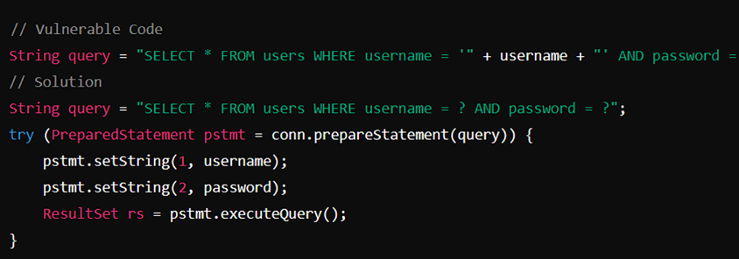
INJECTION FLAWS - SOLUTION
SQL Ijection, Command Injection
-Use of prepared Statements. This approach prevents the SQL injection because the input values are treated like data, instead of a part of the SQL command.
SECURITY ISSUES

Slide 14
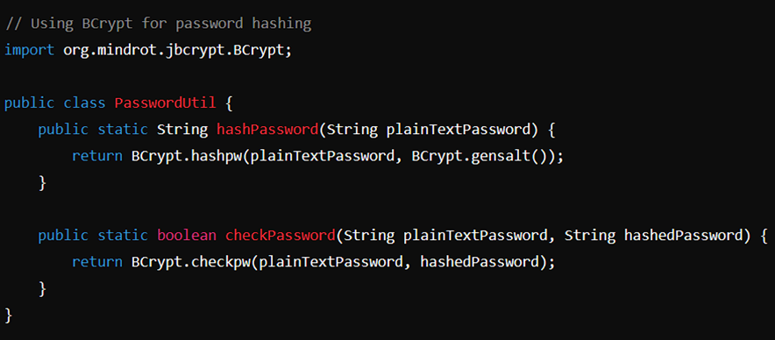
BROKEN AUTHENTICATION AND SESSION MANAGEMENT - SOLUTION
Weak Password Policies, Session Hijacking
-Enforcement of strong password policies by requiring minimum length and higher complexity;
-Multi-factor authentication implementation (MFA);
-Secure Hashing algorithms for password storage.
SECURITY ISSUES

Slide 15
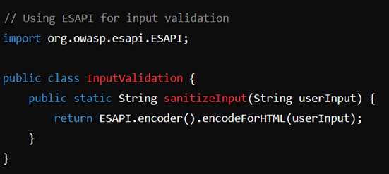
CROSS-SITE SCRIPTING(XSS) - SOLUTIONS
Injection of Malicious scripts into web pages
-Validate and sanitize user inputs;
-Use context-appropriate escaping;
-Implement Content Security Policy (CSP).
SECURITY ISSUES

Slide 16
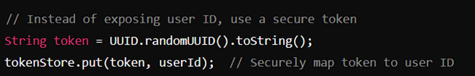
INSECURE DIRECT OBJECT REFERENCES - SOLUTION
Exposing Internal Object References for Users
-Use indirect references such as random tokens;
-Implement access controls to verify user permissions.
SECURITY ISSUES

Slide 17
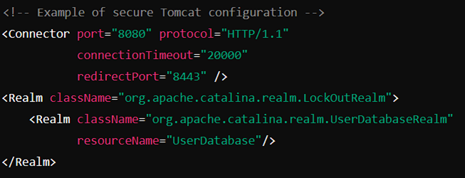
SECURITY MISCONFIGURATION
Using default configurations, insecure settings. (Extensible Markup Language (XML))
-Harden configurations by disabling unused features and services;
-Regularly review and update configurations.
SECURITY ISSUES

Slide 18
DEVELOPER CHECKLIST
Strategies for Resolving Security Issues

Slide 19
STEP BY STEP
Authentication and Authorization
Regular Code Reviews and Testing
Implement Security Headers
Secure Configuration
Data Encryption
Input Validation and Sanitization
Secure Session Management
Error Handling and Logging
Dependency Management
Security Training and Awareness
CHECKLIST

Slide 20
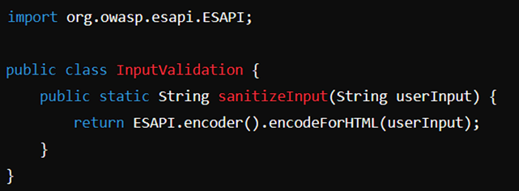
INPUT VALIDATION AND SANITIZATION
Validate Inputs: Validate all inputs from untrusted sources, both client-side and server-side.
Example: Use regex for validating email format;
Sanitize Inputs: Use libraries like OWASP ESAPI to sanitize inputs to prevent XSS.
DEVELOPER CHECKLIST

Slide 21
AUTHENTICATION AND AUTHORIZATION
·Strong Authentication: Implement strong, multi-factor authentication;
Example: Use libraries like Spring Security for implementing MFA.
·Secure Password Storage: Hash passwords using secure algorithms like bcrypt.
·Least Privilege Principle: Ensure users and services have the minimum permissions required;
Example: Configure database roles with least privileges.
DEVELOPER CHECKLIST

Slide 22
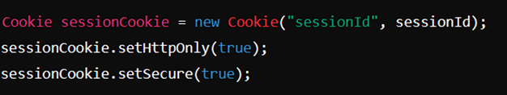
SECURE SESSION MANAGEMENT
·Secure Cookies: Use HttpOnly and Secure flags for cookies.
·Session Timeouts: Implement session timeout and re-authentication mechanisms.
DEVELOPER CHECKLIST

Slide 23
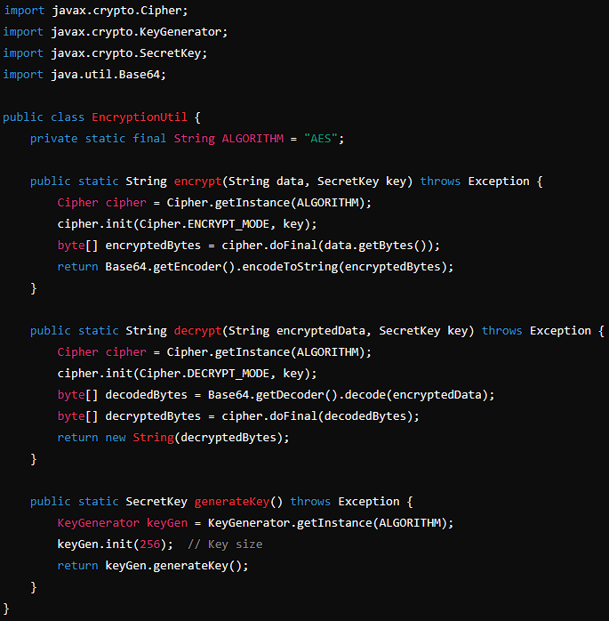
DATA ENCRYPTION
·Encrypt Sensitive Data: Use strong encryption algorithms like AES-256 for sensitive data at rest and in transit.
DEVELOPER CHECKLIST

Slide 24
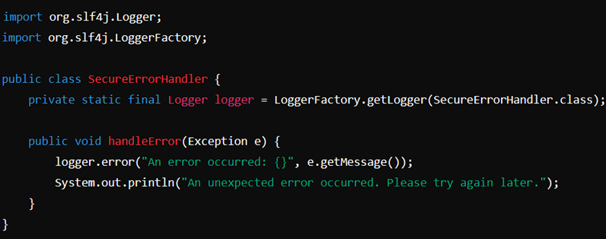
ERROR HANDLING AND LOGGING
Avoid Detailed Error Messages: Do not expose detailed error messages to users.
DEVELOPER CHECKLIST
Secure Logging: Ensure logs do not contain sensitive information and use secure logging practices;
Example: Use SLF4J with logback or log4j.

Slide 25
SECURE CONFIGURATION
·Disable Default Accounts: Ensure default accounts are disabled or removed;
Example: Change default admin passwords.
·Update Configurations: Regularly review and update configurations;
Example: Harden web server configurations.
DEVELOPER CHECKLIST

Slide 26
DEPENDENCY MANAGEMENT
··Update Dependencies: Regularly update third-party libraries and dependencies;
Example: Use Maven or Gradle for managing dependencies.
Use Dependency Scanning Tools: Use tools like OWASP Dependency-Check to identify vulnerabilities.
DEVELOPER CHECKLIST

Slide 27
REGULAR CODE REVIEWS AND TESTING
Conduct Regular Code Reviews: Regularly review code for security issues;
Example: Use peer reviews and automated code review tools.
Static Analysis Tools: Use static analysis tools like SonarQube to detect vulnerabilities.
Security Testing: Perform regular security testing, including penetration testing.
DEVELOPER CHECKLIST

Slide 28
SECURITY TRAINING AND AWARENESS
Regular Training: Provide regular security training for developers;
Example: Conduct workshops and training sessions on OWASP Top Ten.
Stay Updated: Keep updated with the latest security best practices and vulnerabilities.
DEVELOPER CHECKLIST

Slide 29
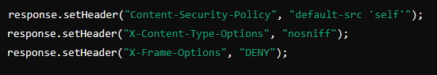
IMPLEMENT SECURITY HEADERS
Security Headers: Use HTTP security headers to protect against common attacks.
DEVELOPER CHECKLIST

Slide 30
THANK YOU FOR WATCHING
THAIS

